Slide 1
Bridging the cost gap between Power and x86
By David Spurway, IBM Power Systems Product Manager

Slide 2
Acknowledgements
This presentation draws heavily on work by the IBM UK Systems Architect, Stewart Dench.
The layout of the majority of the presentation also builds on a style from the IBM USA Competitive Sales Consultant, Rick A. Kearns.
I have also reused the charts created by the IBM UKI Power Systems Product Manager, Steven Atkins, from the Solitaire Interglobal Ltd. “Does your OS Matter?” report.
The statistics included in the model were passed to me by the IBM UK Enterprise LINUX Solution Specialist, Andrew Gadsby, who received them from Innes Read of the IBM Software Group Competitive Project Office in the US.
I also had help working through the algebra for the Central Limit Theorem from IBM UK Financial Management Consultant, Jay Parmar

Slide 3
Agenda
Results Summary
Server Selection
Oracle DB example
The initial cost problem
All cores are not created equal
Virtualisation support
Effect of workload spread
Benefits of a big pool
With or without limits?
Software costs
Adding redundant server
WAS example
Software costs
Adding redundant server
Combined Oracle and WAS example
Other benefits
Summary

Slide 4

Many Factors Affect Choice
Car | Server
Purchase price | Purchase price
Gas mileage, cost of repairs, insurance cost | Cost of operation, power consumption, floor space
Reliability | Reliability
Safety, maneuverability, visibility, vendor service | Availability, disaster recovery, vendor service
Storage capacity, number of seats, towing capacity | Scalability, throughput
Horsepower | Chip performance
Dash board layout Steering wheel location | Instrumentation and skills
Handling, comfort, features | Manageability
Looks, styling, size | Peer and industry recognition
Would you purchase a family car solely on one factor?

Slide 5
Selecting a Platform
Scale
Time Horizon
ISV Support
Deployment
Model
Non-Functional
Requirements
Mainframe
x86
Technology
Adoption
Level
Geographic
Considerations
RISC
Platform
Architecture
Power, cooling,
floor space
constraints
Politics
Strategic Direction
and Standards
Skills
Cost Models

Slide 6
Ideas International and Gartner
About Ideas International (IDEAS) IDEAS provides enterprise IT research, insight, analysis, and tools to computer suppliers and consultants (IT Sellers) and large corporations (IT Buyers). The company’s research focus areas include servers, storage, software, services, and cloud. Many IDEAS tools are powered by RPE2, the atomic unit of compute. IDEAS is a publicly traded company on the Australian Stock Exchange (ASX:IDE) and has been in business for over 25 years. IDEAS hosts users in over 100 countries and maintains offices in the US, EMEA, and Asia Pacific.
31 May 2012
IDEAS is pleased to announce that the takeover offer from Gartner is now unconditional and also follows Gartner having received acceptances from more than 93% of the shareholders for the takeover offer.
http://www.ideasinternational.com/Resources/Press-Releases/Gartner-s-takeover-offer-for-IDEAS-is-successful

Slide 7
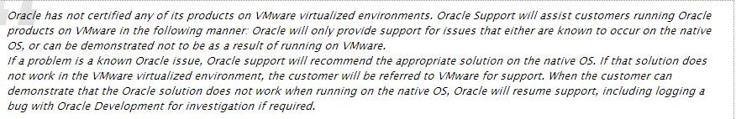
Oracle Certification For VMware and KVM
Running Oracle in a VMware ESX cluster you must license ALL of the cores in the cluster
Oracle DOES NOT recognise VMware as "hard partitioning"
http://blogs.gartner.com/chris-wolf/2010/11/10/oracle-broadens-x86-virtualisation-support-but-work-remains/
Running Oracle in a VMware ESX cluster is not certified. If support is required for unknown problems then you must recreate the problem without VMware installed view Oracle Metalink document 249212.1
Red Hat Enterprise Linux 5 integrates Kernel-based Virtual Machine (KVM) and ships Xen as the default hypervisor, so they are supported by Oracle under the Oracle Linux support program. However, Oracle does not support Oracle products on RHEL's KVM/Xen.
http://www.oracle.com/us/technologies/027617.pdf

Slide 8
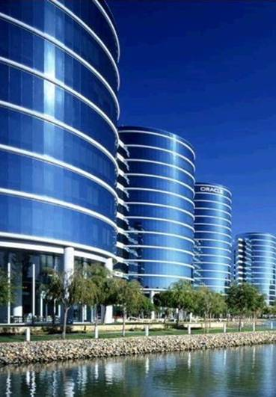
IBM and Oracle Have a Long-Standing Relationship
Sustaining relationship of 120K + clients
Coopetition is alive and well
Oracle 22 years, PeopleSoft 20 years, JD Edwards 31 years, Siebel 10 years
More than 120K joint technology clients
And more than 20,000 joint application clients
Vibrant technology relationship
Sustained investment in skills and resources including dedicated international competency centres
Market-leading services practice
IBM GBS is Oracle’s #1 SI partner (7,500 joint projects) with 5,000 people dedicated to Oracle
Unrivalled client support process
Dedicated on-site resources and significant program investments
Oracle Databases (along with most other Oracle products) are fully certified on IBM Power Systems, including the use of PowerVM virtualisation, Micropartitioning, PowerHA and Live Partition Mobility (LPM certified for Single Instance DB only).
http://www-03.ibm.com/support/techdocs/atsmastr.nsf/WebIndex/PRS3369
Notes:
8
IBM has a long-standing relationship with Oracle; both technologically and from a sales execution standpoint. Yes we compete, but we have a core set of clients that run Oracle products on IBM hardware and that keeps our relationship strong. Since 1986, IBM and Oracle have worked together to create smart, serious innovation that’s helping to shift the world. More than 100,000 joint clients benefit from the strength and stability of the Oracle and IBM alliance, which offers technology, applications, services and hardware solutions that help mitigate risk, boost efficiency and lower total cost of ownership.
IBM’s service organization, IBM Global Business Services, is an Oracle Certified Advantage Partner and has a proven track record with over 5,000 experienced professionals who have completed over 7,500 Oracle projects. IBM and Oracle continually enhance the alliance to ensure they are helping companies respond quickly to constantly shifting market conditions and demands. This is accomplished through the delivery of industry-specific hardware and software solutions optimized to the client’s environment. To further assist clients, we have an IBM Oracle Competency Center, that does benchmarking, proof of concepts, best practices and sizing methodology on the application and technology side.

Slide 9
Resource utilisation through virtualisation Single Server
Peak (minimum size of server)
59 cores for single server

Slide 10
Resource utilisation through virtualisation First server of two
Peak (minimum size of
first server) 25 cores

Slide 11
Resource utilisation through virtualisation Second server of two
Peak (minimum size of
second server) 43 cores

Slide 12
Results of splitting workloads from one server across two
Peak (minimum size of server) 59 cores for single server
+
=
Peak (minimum size of
first server) 25 cores
Peak (minimum size of
second server) 43 cores
A minimum of 68 cores needed in two server solution
(an increase of ~15% over single server solution)

Slide 13
Resource utilisation through virtualisation First server of three
Peak (minimum size of
first server) 19 cores

Slide 14
Resource utilisation through virtualisation Second server of three
Peak (minimum size of
first server) 29 cores

Slide 15
Resource utilisation through virtualisation Third server of three
Peak (minimum size of
first server) 30 cores

Slide 16
Results of splitting workloads from one server across two or three
Peak (minimum size of server)
59 cores
+
=
Peak (minimum size of
first server) 25 cores
Peak (minimum size of
second server) 43 cores
A minimum of 68 cores needed in two server solution
(an increase of ~15% over single server solution)
Peak (minimum size of
first server) 19 cores
+
Peak (minimum size of
first server) 29 cores
+
Peak (minimum size of
first server) 30 cores
=
A minimum of 78 cores needed in three server solution
(a further increase of ~15% over two server solution)

Slide 17
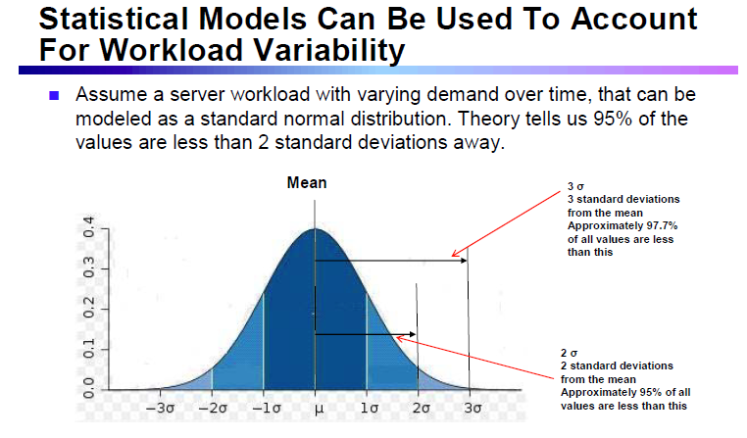
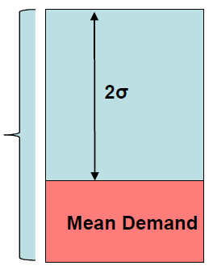
Adding some Statistical Theory to the model - SLAs
To meet a 95% SLA, we need a server with a total capacity of (Mean Demand + 2σ)
Open paper "A Benchmark Study on Virtualization Platforms for Private Clouds"

Slide 18
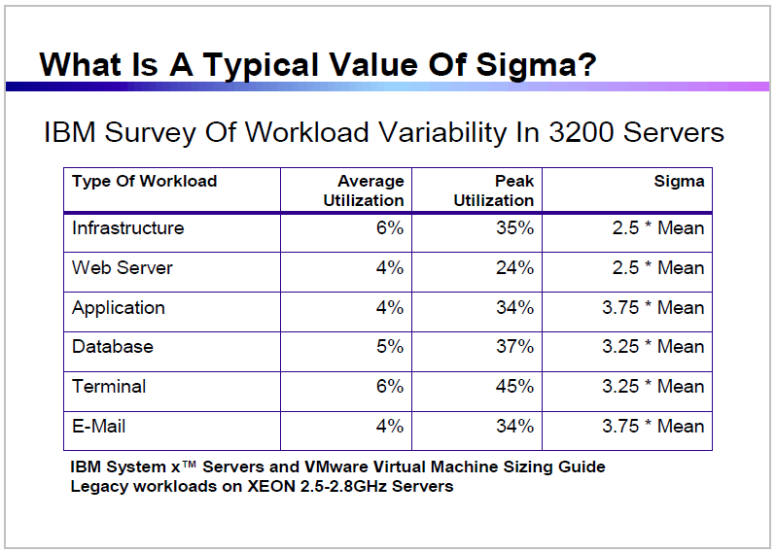
Adding some Statistical Theory to the model - Sigma
Open paper "A Benchmark Study on Virtualization Platforms for Private Clouds"

Slide 19
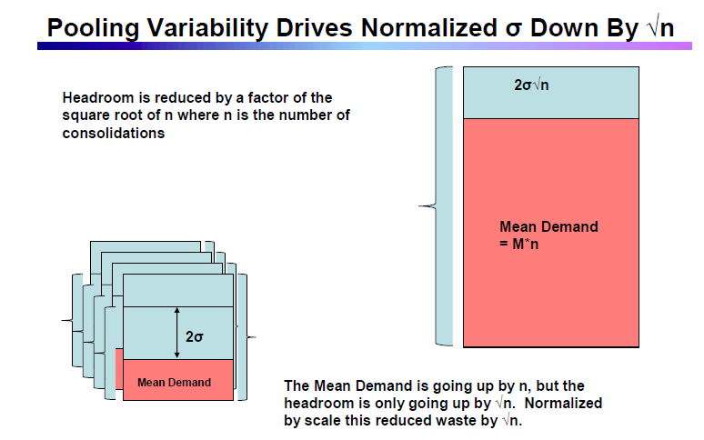
Adding some Statistical Theory to the model – Central Limit Theorem
Open paper "A Benchmark Study on Virtualization Platforms for Private Clouds"

Slide 20
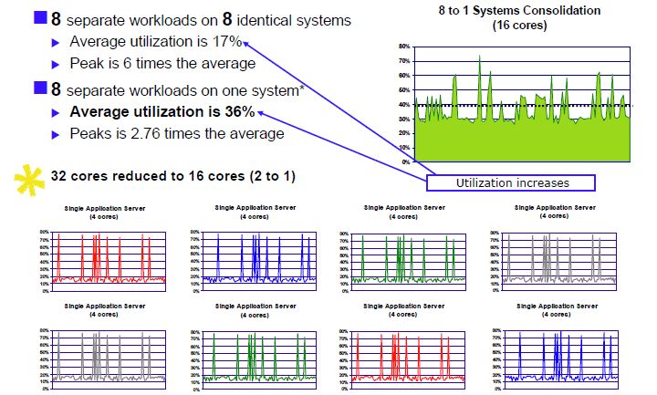
Statistical Multiplexing drives up utilisation

Slide 21
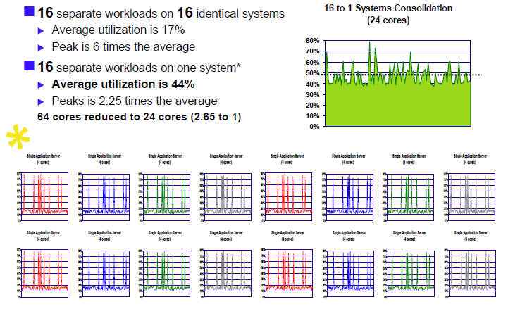
Statistical Multiplexing drives up utilisation – bigger servers are better

Slide 22
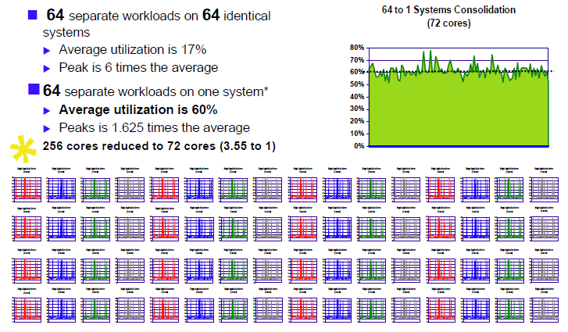
Statistical Multiplexing drives up utilisation – even bigger servers are better

Slide 23
Summary
All cores are not created equal
IBM Power can run more threads faster, which means workloads run faster and less cores are needed, which lowers costs
With IBM Power, virtualisation is built into the hardware, adds no overhead and is always on.
Less resources are therefore needed, reducing costs.
IBM Power allows larger pools of virtualised resources.
Spikes in workloads can be accommodated with fewer resources. Less resources are therefore needed, reducing costs.
Software costs and the facilities requirements can be considerable
IBM Power servers can lower both, allowing high levels of expense to be avoided.
IBM Power and AIX then have a number of features that add value above Linux on x86
More secure, less patching needed, can virtualise any workload, LPM, RAS, Active Memory Sharing and Expansion, WPARs, etc
Taking in all these elements, IBM Power Systems offer solutions that can save money over x86 based solutions, and deliver higher levels of business value.

Slide 24

Conclusions and possible next steps
Hopefully my modelling and ideas have given some food for thought
But how the customer models costs and assigns value is far more important
Can we work with you on your models, working some of these ideas in, so IBM Power systems can compete effectively for workloads?
Thank you!
David Spurway – IBM Power Systems Product Manager
Email: david.spurway@uk.ibm.com
Phone: 07717 892 896

Slide 25



AIX V6.1 Security Expert
Back
How it can help?
What is it?
A centralized security management tool that can control over 300 security settings from a single console
Administrators can start from a “Low”, “Medium”, “High” or “Sarbanes-Oxley” security template and customize settings to met business requirements
Security settings can be exported and imported as a security profile to multiple systems
On AIX V6.1, security profiles can be stored in an LDAP directory for ease of distribution
AIX Security Expert was first included in AIX V5.3 TL5
Go Green & Save
Can reduce the cost and complexity of security administration by allowing federated management of security profiles across multiple servers
Enables a more secure IT infrastructure by reducing the effort of maintaining system security
“Check” functionality can provide additional security by validating that the security profile for each system matches the actual security settings
Manage Growth, Complexity & Risk
Allows for new ways to efficiently manage security across multiple AIX systems
Realize Innovation
Notes:
The AIX Security Expert was introduced with Technology Level 5 up-
date to the AIX V5.3 OS and provides clients with the capability to
manage more than 300 system security settings from a single inter-
face and the ability to export and import those security settings
between systems. AIX 6 includes an enhancement to the Security Ex-
pert to store security templates in a Lightweight Directory Protocol
(LDAP) directory for use across a client's enterprise.
-Before AIX Security Expert security settings were distributed among a variety of system and network commands and separte SMIT panels
-creating proper default settings was very difficult
-administrators would harden their systems by running home grown scripts that evolved over time
Difficult to ensure the compliance to settings created in these scripts
Use a GUI to review check box style of settings
Allows security settings to be standardized and to be invoked early in the boot process to prevent systems from being vulnerable on the network,
before customer scripts are invoked
AIX SE hardens systems by ensuring the proper configuration based on a desired level of security
The AIX 5L Security Expert was introduced with Technology Level 5 of AIX V5.3 OS, it provides clients with the capability to manage more than 300 system security settings from a single interface and the ability to export and import those security settings between systems. In AIX V6.1 OS it includes an enhancement to store security templates in a Lightweight Directory Protocol (LDAP) directory for use across a client's enterprise to help centralize its administration

Slide 26
AIX V6.1 Encrypting Filesystem
Back
How it can help?
What is it?
The capability to automatically encrypt data in a JFS2 filesystem
Data can be protected from access by privileged users
Backup in encrypted or clear formats
Automated key management - key store open on login, integrated into AIX security authentication
Each file encrypted with a unique key
No keys stored in clear in kernel memory
A variety of AES, and RSA cryptography keys supported
Go Green & Save
Enables improved security by reducing unauthorized access to data, even by privileged users
Secure backups reduces the exposure of data compromised when backup media is taken outside of secure facilities
Automatic management of protection keys can reduce the administrative effort of using encrypted data
Manage Growth, Complexity & Risk
Provides the capability for additional security for applications that may have security design exposures
Realize Innovation
Notes:
The IBM Journaled Filesystem Extended (JFS2) provides for even
greater data security with the addition of a new capability to en-
crypt the data in a filesystem. Clients can select from a number of
different encryption algorithms. The encrypted data can be backed up
in encrypted format, reducing the risk of data being compromised if
backup media is lost or stolen. The JFS2 encrypting filesystem can
also prevent the compromise of data even to root-level users.

Slide 27
AIX and Linux – Side by Side
Back
 | AIX | Linux on x86
Commercial Application Availability | Best | Better
Hardware First-Failure Data Capture and diagnostic fault isolation capabilities | Best | No
Vertical Scalability | Best | Good
Open Source Application Availability | Good | Better
Virtualization Support | Best | Good
Dynamic Processor De-allocation | Best | No
Mainframe inspired Operating System First Failure Data Capture and OS fault isolation | Best | No
Predictive failure analysis on processors, caches, memory, I/O and DASD | Best | No
Binary Compatibility | Best | Good
Manageability | Better | Good
Notes:
27

Slide 28


PowerVM delivers superior security to help manage risk and maximize availability
Back
Risk Management Factors | VMware ESX 3.5 (in VMware Infrastructure 3) | VMware vSphere 4 & 5 | PowerVM
Implementation of virtualization technology | Third-party software add-on | Third-party software add-on | Integrated into server firmware
Isolation of I/O drivers from hypervisor | No | No | Yes (using VIOS)
Live migration across processor generations | No | Some (with Intel FlexMigration) | Yes (Power6-Power7)
Source: http://www.vmware.com/files/pdf/products/vsphere/vmware-what-is-new-vsphere5.pdf
Notes:
Finally, PowerVM also outpaces VMware when it comes to managing risk and ensuring that all virtualized workloads run within a robust and highly-secure environment.

Slide 29

PowerSC Standard Edition
PowerSC provides a security and compliance solution to protect datacenters virtualized with PowerVM enabling higher quality services
Business Requirements
Compliance and Audit
Guarantee that the OS has not been hacked or compromised in any way
Ensure that every Virtual System has appropriate security patches
Compliance and Audit to External Standards
Capabilities
Tamper-proof logs
Defense against tampering
Notification of unpatched systems
Compliance automation and reporting
Trusted Logging
The SVM/VIOS capture all LPAR audit log information in real time.
Trusted Boot
Boot images and OS are cryptographically signed and validated using a virtual Trusted Platform Module (vTPM)
Trusted Network Connect
and Patch Management
With the Trusted Network Connection protocol imbedded in the VIOS, we can detect any system attempting to access the network and determine if it is at the correct security patch and update level.
Security Compliance Automation (PowerSC Express)
Pre-built compliance profiles that match various industry standards such as Payment Card Industry, DOD and Sox/Cobit. Activated and Reported on centrally using AIX Profile Manager
Notes:
Explain that every business has business requirements that must be met to stay in business. They include the column on the left. Each of the PowerSC features in the middle are fulfilling the business requirements and are providing capabilities on the right hand column.
PowerSC monitors and detects changes in the environment so that businesses will know if they are compliant to the security policies and standards.

Slide 30

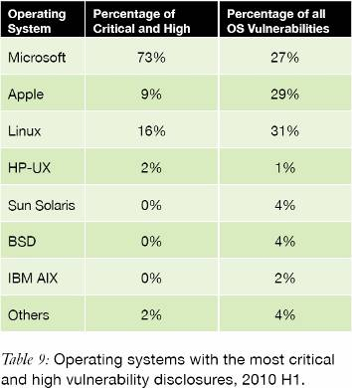
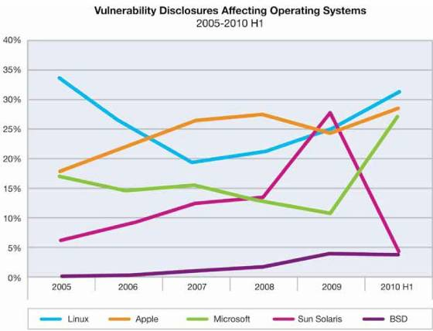
AIX Provides Leadership Security*
AIX Dropped off the list due to low vulnerabilities!
*X-Force report – Mid-year 2010 http://www-935.ibm.com/services/us/iss/xforce/trendreports/

Slide 31
AIX/POWER versus Linux/Commodity x86
Advantages of Power AIX Systems Relative to Commodity Linux x86 Servers
Systems Administration cost comparison
From “VALUE PROPOSITION FOR AIX ON IBM POWER SYSTEMS : OWNERSHIP EXPERIENCES COMPARED
WITH LINUX ON COMMODITY X86-BASED SERVERS” International Technology Group ©2010
Available on ibm.com/AIX
Notes:
Comparing AIX and Linux
What is the difference between AIX and Linux? That question can be answered in multiple ways. From a technical perspective, both are variants of the UNIX operating system originally developed at AT&T in 1969. They share many technologies and standards, but have developed in different directions.
AIX is IBM’s version of UNIX, introduced in 1986 and extensively updated and enhanced since that time. It is the primary operating system for the IBM line of RISC-based Power Systems. Linux is an “open source” kernel originally developed in 1991, and subsequently enhanced in multiple distributions. It runs mainly upon “commodity” x86 servers.
From a practical perspective, there are other differences. According to users, Power Systems and AIX deliver levels of availability, performance, scalability, manageability and security that are – by wide margins – higher than for Linux and x86 servers. Virtualization and system management capabilities, and failover solutions are significantly better. Higher-quality service and support are available.
The AIX operating system is also considered to be more stable, and its evolution more predictable, than is the case for even major Linux distributions such as Novell SUSE Enterprise Linux (SLES) and Red Hat Enterprise Linux (RHEL). This translates into significant benefits in development and system administration productivity, and in reduced risk for organizations that employ it.
These conclusions are based on input from 27 organizations that have made major investments in Power AIX systems as well as in SLES and/or RHEL on x86 servers. This group reported the advantages of Power AIX systems over Linux x86 servers to be as shown in figure 1.
These results are consistent with other sources. For example, industry surveys have consistently shown higher levels of availability for Power Systems than for any other non-mainframe platform. These are also recognized leaders in performance and scalability.
The advantages of employing “hard” partitioning technologies such as Power Systems microcode-based logical partitions (LPARs) have also been widely documented.
Highly granular partitioning – LPARs can be configured in increments as small as 1/100th of a processor core – and tightly integrated system and workload management enable organizations to realize higher levels of consolidation than may be achieved using software-based x86 server virtualization tools such as VMware and Xen. This is the case even for performance- and availability-sensitive production systems.
Integration and optimization of hardware, firmware and software features have led to capabilities in Power Systems and AIX that provide major value to users. The level of integration is significantly less for commodity x86 hardware platforms, Linux distributions and third-party tools supporting these.
Examples of such capabilities include Simultaneous MultiThreading (SMT), Intelligent Cache and TurboCore mode for latest-generation POWER7-based systems. These not only boost overall performance, but also allow hardware and software resources to be configured to execute specific types of workload in a highly efficient manner.
Other capabilities include industry-leading reliability, availability and serviceability (RAS) and energy efficiency features, along with kernel exploitation of POWER Storage Keys, which allows AIX to use a unique Power Systems hardware feature to prevent software errors that cause more than 75 percent of UNIX system crashes.
Although Power Systems play a major role in differentiating AIX and Linux, many users saw the technology content of the AIX operating system as offering significant advantages. Key AIX capabilities had been developed and enhanced over long periods – in some cases for close to two decades.
IBM enhancement and support policies were also seen as providing benefits not offered by the Linux “open source” model. Greater predictability, maintenance of binary compatibility between versions, and consistency of IBM service and support meant that there were, to quote one user, “no surprises.”
It should be emphasized that the advantages of AIX compared to RHEL and SLES did not preclude use of these. However, it did mean that they were recognized as higher-risk options. Organizations were less willing to employ them for applications that supported large user populations, or major business processes, and for which high quality of service was required.
Cost Picture
It is often argued that Linux x86 servers offer a lower-cost alternative to Power Systems and AIX. This view may be questioned on a number of grounds.
One is that, as survey results indicate, AIX and Linux are typically used for different applications. RHEL and SLES are most commonly used to support Web services and infrastructure functions, and for comparatively light-duty business and productivity applications. Power Systems and AIX tend to support systems with larger databases and user populations, and more demanding workloads.
Industry experience has shown that, if Linux x86 servers are employed in such roles, cost structures change rapidly. More powerful hardware, larger numbers of servers, and additional software for high availability, system management and other functions are typically required. Third-party virtualization tools such as VMware increase costs further.
Higher levels of consolidation and system administrator productivity enabled by Power Systems and AIX also mean that personnel costs may be significantly lower than for Linux x86 servers.
In four examples presented in this report, lower full time equivalent (FTE) staffing for Power Systems and AIX result in three-year system administration personnel costs that average 58 percent less than for use of commodity Linux x86 servers.
Calculations are based on user installations in financial services, IT services and manufacturing companies, and in a major government agency. Existing Power Systems and AIX configurations and FTE system administration staffing were compared with those that would be required to support the same applications and workloads using commodity Linux x86 servers.
Details of these installations, and of configurations, FTE staffing and cost calculations may be found in the Detailed Data section at the end of this report.
Conclusions
Among the organizations surveyed for this report, none planned to phase out Power Systems and AIX in favor of Linux x86 servers, and the reverse was also the case. Although there were some areas of overlap, the functional capabilities of and value propositions for these platforms were clearly differentiated.
To quote one user, it was not “an either/or issue.” It is difficult to disagree with this conclusion. Both can provide value, and the opportunities afforded by both should be pursued.
One further point should be noted. As adoption of new Power Systems hardware and AIX versions tends to lag IBM introduction cycles, many organizations had not fully exploited the capabilities of POWER6-based systems and AIX 6, which were introduced in 2007. None had experience with POWER7-based systems, which were introduced in February 2010. These are discussed later in this report.
In the following sections, user responses are first presented, and issues raised by these are discussed (User View). The technical capabilities of Power Systems and AIX are then outlined (Technology View).
Additional Information
This ITG Executive Summary is based upon results and methodology contained in a Management Brief released by the International Technology Group. For copies of this Management Brief, please email requests to info-itg@pacbell.net.

Slide 32
PowerSC PCI profile - example content
Payment Card Industry Data Security Standard V2
Notes:
This is just a subset of the settings associated with the Payment Card Industry.

Slide 33
Some questions to consider
What are you planning to run?
What is the reliability needed?
How flexible does it need to be?
Do you have peaks during the year, month, and/or week and how do you handle them?
How secure does it need to be?
How complicated it is to install and run?
What skills your staff already have?
What would be your evaluation criteria?
Which of these business needs would have more weight?
Do you have a total budget assigned for this project?
Notes:
Made customer feel he needed to answer these points immediately, rather than keep in mind for new projects

Slide 34
声明：
所有的版权属于原有公司，文件均来自公开渠道
此文件仅供学习使用，任何人不得进行以此为商业目的的行为
如有疑问，请立即删除
学习世界五百强和咨询公司PPT课程请访问如下网站搜索：“司马懿”
百度传课：司马懿PPT学校
网易学堂：司马懿PPT学校
知乎： 司马懿PPT学校
访问地址
https://www.chuanke.com
访问地址
https://study.163.com
访问地址
https://www.zhiu.com

